Slide 1
Logic Families and Semiconductor Memories

Slide 2
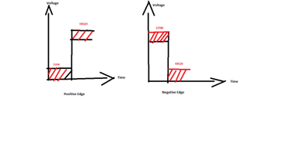
Digital logic Families
A group of compatible ICs with same logic levels and supply voltage fabricated for performing various logic functions referred to as a logic family

Slide 3
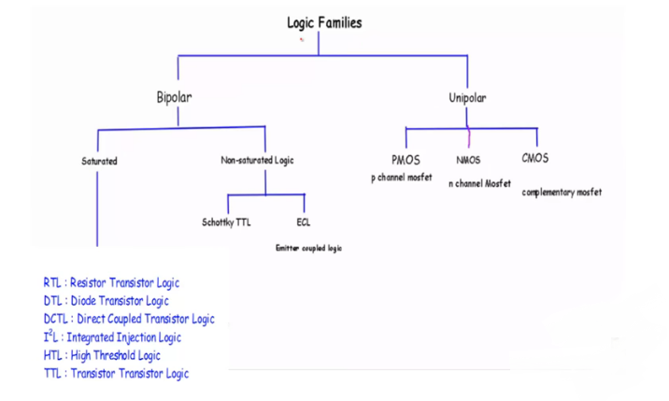
Logic Families

Slide 4
Digital ICs is fabricated by two types
1. Bipolar Logic Families : Used both electrons and holes as charge carrier
2. Uni-polar Logic Families : Used only one type of charge carrier ,either electron or holes

Slide 5
Bipolar logic families
Saturated Logic Circuits : In which the transistors are driven into saturation.
Ex. TTL, RTL, DTL
Non-Saturated Logic : In non-saturated transistor logic circuits, the transistors are avoided to go into saturation.
Ex. ECL, Schottky TTL

Slide 6
Characteristics of Digital ICs
Propagation delay
Power dissipation
Figure of merits
Fan-in
Fan-out
Noise margin
Operating temperature

Slide 7
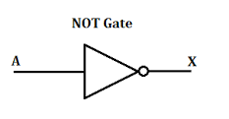
Propagation Delay
The propagation delay of a Gate is a average transition time that the signal takes to propagate from input to the output .
In other words it is defined as the time interval between a change in input state and the resulting change in output state of the gate.
This delay is a very small quantity; it is of the order of few nano second say 20 nsec (20x10-9 sec) or 50 nsec (50x10-9 sec).

Slide 8
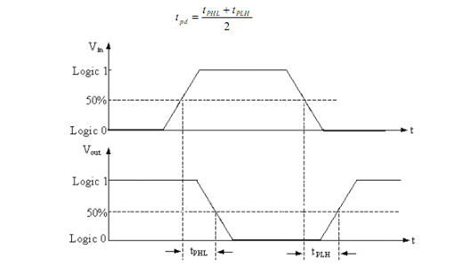
Cont.
The propagation delay time is measured between 50% voltage levels of input and output waveforms.
Figure shows the input and output waveforms of an inverter or NOT gate.
If t_{PHL} is the delay time when the output goes from high state (logic 1) to low state (logic 0) and t_{PLH} is the delay time when the output goes from low state (logic 0) to high state (logic 1), the propagation delay time of the gate t_{PD} expressed as the average of the two delays as

Slide 9
Cont.
The speed of operation of gate is specified in terms of propagation delay.
It is always advantageous to be the smaller propagation delay, so that speed of operation should be high.

Slide 10
Power Dissipation
It is the amount of power dissipated in an IC in the form of heat.
Excessive temp. could damage the IC. So power dissipation must be less.
It is calculated as the product of the voltage Vcc and the current Icc that is drawn from the voltage Vcc ,applied to an IC .
Power dissipation Pd = Vcc * Icc
Average power dissipation Pd(Avg)= Vcc * Icc(Avg)
Where , Icc(Avg)=( Icch+Iccl)/2
Measured in few milli-watts.
A low value of this product is desirable.

Slide 11
Figure of merit
The product of speed and power dissipation per gate is known as the figure of merit of the logic family.
It is desirable that figure of merit should be low.
Measured in picojouls.
Figure of merit= Propagation delay * Power dissipation

Slide 12
Fan in
The maximum number of inputs that can be applied to a logic gate is known as Fan – in.
Thus a three input AND has fan – in as three.

Slide 13

Fan out
The fan –out of logic gate is the number of gates that can be driven by it.
Thus, if a fan-out of a typical gate is 10, then it implies that this gate can drive 10 such gates.

Slide 14
Operating Temperature
The temperature range in which an IC functions properly is known as the operating temperature of the gate.
It is specified by the manufacturer.
The acceptable temperature range of the ICs is from 0 ⁰C to 70 ⁰C for commercial applications and this range is from – 55 ⁰C to 125 ⁰C for military purposes.

Slide 15
Noise Margin
Spurious signals called noise are sometimes generated in the connecting leads of the logic circuits due to the stray electric and magnetic fields in the surroundings.
This results the unpredictable operation of the logic circuit.
Therefore, this parameter(Noise margin) allows us to determine the allowable noise voltage on the input of a gate so that the output will not be affected.
The noise margin is sometimes called Noise- immunity.
The large noise margin is always desirable

Slide 16
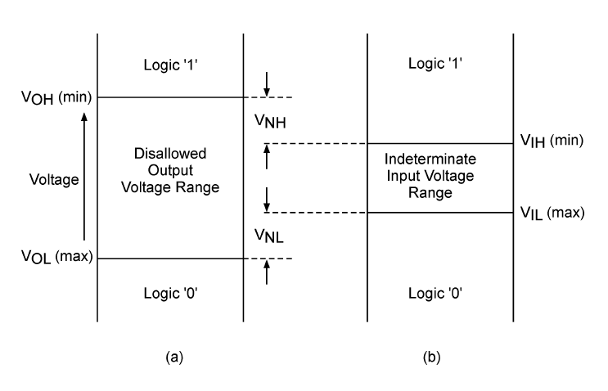
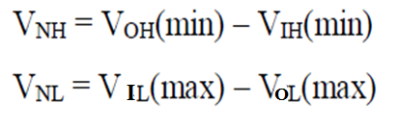
Cont.

Slide 17
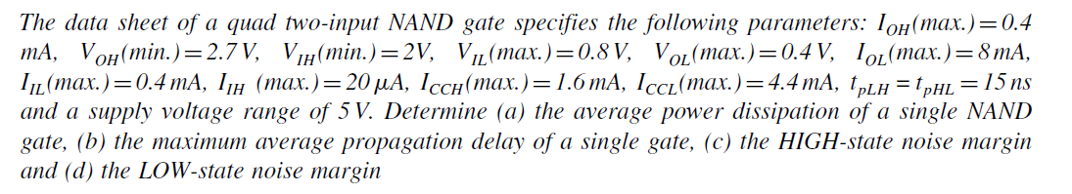
Question

Slide 18
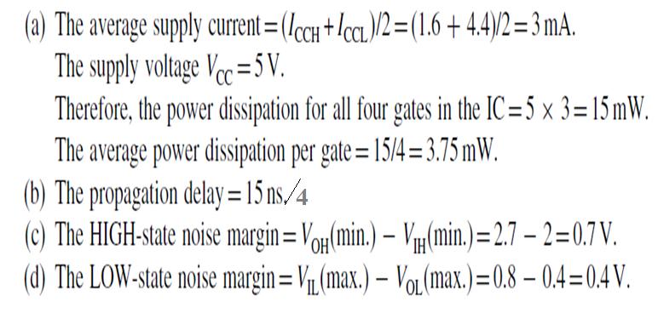
Solution

Slide 19
Register Transistor Logic(RTL)
The resistor–transistor logic is the most common family of logic circuits. It consists of resistors and transistors hence known as resistor transistor logic.
Let us assume-
Low 0 v
High 5v

Slide 20
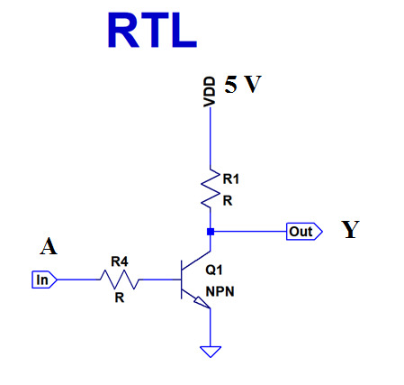
RTL Inverter
A (In) | Y (Out) | Q 1 | Discription
0 | 1 | OFF | Q 1 act as open circuit therefore Direct connection of output Y to Vdd which is very high voltage
1 | 0 | ON | Q1 acts as short circuits therefore direct Connection to ground which is very low voltage

Slide 21
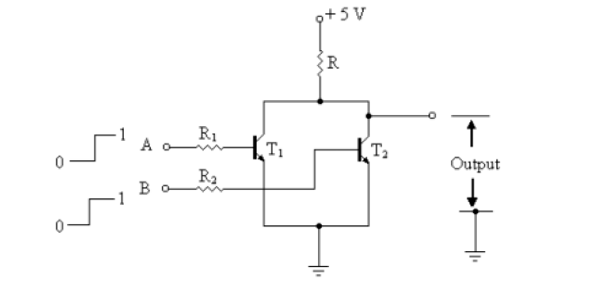
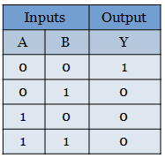
Register Transistor Logic(RTL)
Low 0 v
High 5v

Slide 22
Cont.
When both the inputs A and B are at 0 V or logic 0, it is not enough to turn on the gates of both the transistor. So the transistors will not conduct. Due to this, the voltage +Vcc will appear at the output Y. Hence the output is logic 1 or logic HIGH at terminal Y.
When any one of the inputs, either A or B is given HIGH voltage or logic 1, then the transistor with HIGH gate input will be turned on. This will make a path for the supply voltage to go to the ground through the resistor R and transistor. Thus there will be 0 v at the output terminal Y.
When both the inputs are HIGH, it will drive both the transistor to turn on. It will make a path for the supply voltage to flow to the ground through resistor R and transistor. Therefore, there will be 0 v at the output terminal Y.

Slide 23
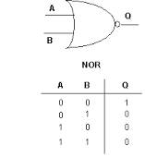
Conclusion
It is concluded that it performs the operation of the NOR gate

Slide 24
Disadvantage
Power dissipation is high.
low noise margin and
its propagation delay is relatively larger.

Slide 25
Diode Transistor Logic (DTL)
In DTL diodes and transistor are used hence the name diode transistor logic.
Improved version of RTL

Slide 26
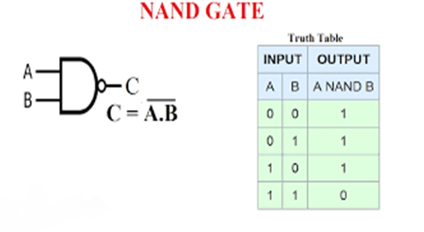
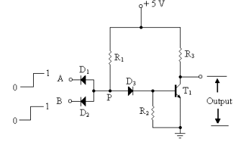
Diode Transistor Logic (DTL)
Low 0 v
High 5v

Slide 27
Description
When both the inputs A and B are at 0 V or logic 0, Both Diode D1 & D2 will conduct but this voltage is not sufficient to turn on Diode D3 at point P, therefore transistor T1 also will not conduct. . Due to this, the voltage +Vcc will appear at the output Y. Hence the output is logic 1 or logic HIGH at terminal Y.
When any one of the inputs A or B is at 0 V or logic 0, any one Diode D1 or D2 will conduct respectively, but again this voltage is not sufficient to turn on Diode D3 at point P, therefore transistor T1 also will not conduct. . Due to this, the voltage +Vcc will appear at the output Y. Hence the output is logic 1 or logic HIGH at terminal Y.
When both the inputs A and B are at HIGH or logic 1, Both Diode D1 & D2 will not conduct therefore high voltage +Vcc will appear to turn on Diode D3 at point P, thus transistor T1 also will conduct. It will make a path for the supply voltage to flow to the ground. Therefore, there will be 0 v at the output terminal Y.

Slide 28
Conclusion
It is concluded that it performs the operation of the NAND gate .

Slide 29
Advantage
Greater fan out
Improved noise margin
Disadvantage
Slow speed

Slide 30
Transistor Transistor Logic (TTL)
The TTL or Transistor-Transistor Logic logic was invented in the year 1961 by “James L. Buie ”
In 1963, the manufacturing first commercial TTL devices were designed by “Sylvania” known as SUHL or ‘Sylvania Universal High-Level Logic family’.
After the Texas instruments engineers launched the 5400 series ICs in the year 1964 with the range of military temperature, then the Transistor-Transistor Logic became very popular.

Slide 31
Transistor-Transistor Logic (TTL)
The Transistor-Transistor Logic (TTL) is a logic family made up of BJTs (bipolar junction transistors).
Improved version of DTL
As the name suggests, the transistor performs two functions like logic as well as amplifying.
The best examples of TTL are logic gates namely the 7402 NOR Gate & the 7400 NAND gate.
TTL logic includes several transistors that have several emitters as well as several inputs.
The designing of TTL logic gates can be done with resistors and BJTs.
There are several variants of TTL which are developed for different purposes such as the radiation-hardened TTL packages for space applications and Low power Schottky diodes that can provide an excellent combination of speed and lesser power consumption.

Slide 32
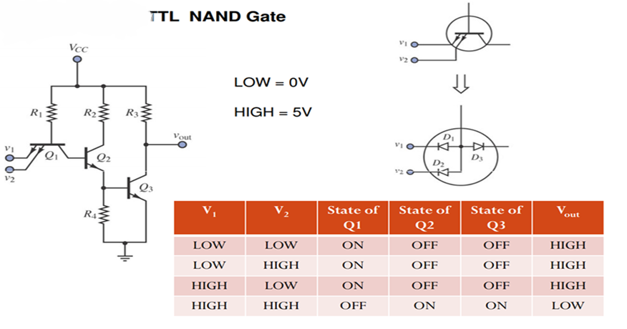
TTL NAND Gate
A | B | Y
0 | 0 | 1
0 | 1 | 1
1 | 0 | 1
1 | 1 | 0

Slide 33
Cont.

Slide 34
Advantages
Power dissipation is low.
High noise margin and
its propagation delay is relatively larger.
Greater fan out
Improved noise margin

Slide 35
Tristate TTL
The tri-state devices allow three possible output states namely, High, Low and High impedance.
The high impedance state offers high impedance between the output terminal and ground or positive supply. Output in this case is floating.
In this circuit input A is the normal logic input while the ENABLE E terminal is an enable input that can produce high impedance output/Tristate output/High Z.

Slide 36
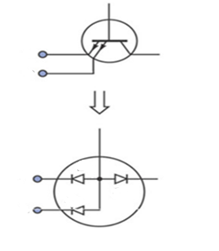
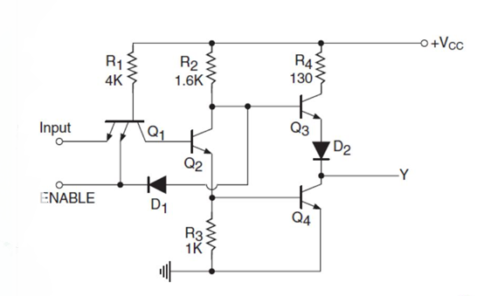
Tristate TTL
Low 0 v
High 5v
E | I/P | D1 | Q2 | Q3 & D2 | Q4 | Y
1 | 0 | off | off | on | off | 1
1 | 1 | off | on | off | on | 0
0 | 0 | on | off | off | off | High- Z
0 | 1 | on | off | off | off | High- Z

Slide 37
Cont.
When ENABLE E terminal is high (logic 1), the diode D1 remains in reverse bias/Off so it has no effect on the working of transistors Q3 and Q4 and therefore circuit operates as normal inverter.
When ENABLE E terminal is low (logic 0), the diode D1 will be in forward bias and it takes away the base current of transistor Q3. So this transistor will be turned off.
The forward bias/on diode D1 also forward biases the emitter base junction of the transistor Q1, transistor Q2 will therefore be turned off, which turns off the transistor Q4. So by applying logic 0 to the ENABLE E terminal both the transistors Q3 and Q4 of output go in cutoff state and hence output comes as High impedance state.
The high impedance state offers high impedance between the output terminal and ground . Output in this case is floating

Slide 38
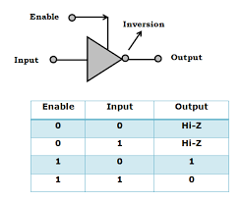
Conclusion
It is concluded that Tristate TTL works as Tristate TTL inverter .
NOTE- It is available in others gate also

Slide 39
Advantages
The tri-state configuration is possible with other gates also with the similar circuits.
its speed is also fast.

Slide 40

Thanks

